Slide 1
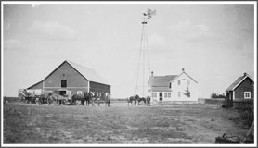
American Agricultural Development
1900-1959
AG 101
Ag & The Modern World

Slide 2
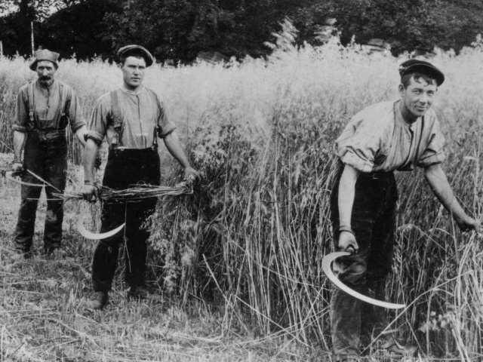
STATS: 1900 – 1910
1900
1910
Total Population
  76 million
Farmers
  38% of labor force
Number of farms
  5.7 million
Average acres
  147 acres
Ag Exports
  $917 million
    58% of total exports
  Europe is biggest export market for US Agricultural goods
Total Population
  92 million
Farmers
  31% of labor force
Number of farms
  6.3 million
Average acres
  138 acres

Slide 3
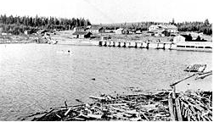
1900: A New Century for Agriculture
Industrial technology brought widespread improvements to farmers.
Dams supplied irrigation water to dry land.
Machines decreasing manpower needed on farm
  Freed Americans to pursue new endeavors
USDA Scientists introduced new plant to American farmers:
  Nectarines (Afghanistan)
  Broccoli (Italy)
  Seedless grapes (Italy)
  Avocado (Chile)

Slide 4
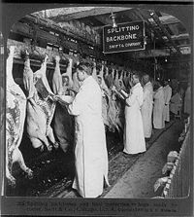
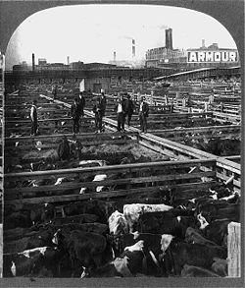

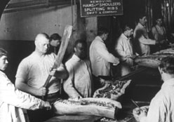
The Emergence of Modern America: 1900-1910
1906 = The Pure Food and Drug Law was enacted.
  Required the USDA to inspect the cleanliness of Agricultural goods
  Response to public outcry after Upton Sinclair’s novel, “The Jungle”
    Described horrendous conditions in Chicago’s meat-packing district

Slide 5
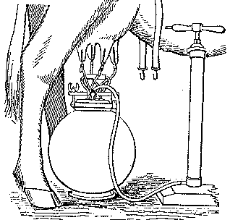
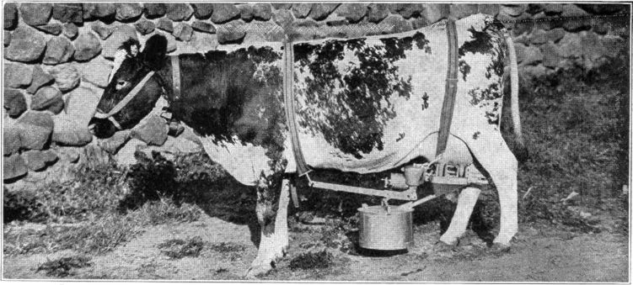
The Emergence of Modern America: 1900-1910
1908
  First electric milking machine patented
1900-1920
  Extensive experimental work to breed disease-resistant varieties of plants, to improve plant yield and quality, and to increase the productivity of farm animal strains

Slide 6
War Time Boom: 1914-1917
Europe engaged in World War I in 1914.
  Busy fighting, these nations struggled to feed their citizens and soldiers.
The USDA urged American farmers to step up production to meet increased demand at home and abroad.
  Agricultural exports soared
  Farm prices more than doubled.
  This boom renewed business interest in farming
    1916 President Woodrow Wilson signed the Farm Credit Loan Act to provide long-term loans to farmers.
  With money for expansion, farmers purchased nearly 50,000 tractors and put 40 million acres of new land into production in 1917.
  The war effort also saw meat production swell by more than 20%
  Agricultural scientists developed methods for dry farming that made it possible to grow wheat and hay in arid areas of the United States without irrigation.

Slide 7
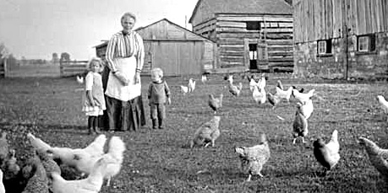
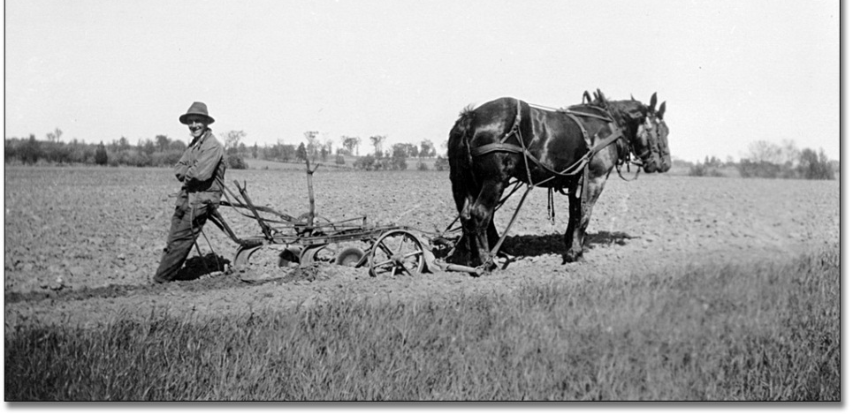
Rural Migration: 1920s
Rural quality of life lower than urban/city
  40% rural homes without indoor plumbing or electricity
  Led to USDA nutritional programs for rural families

Slide 8
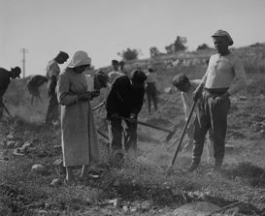
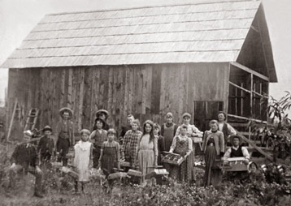
The Emergence of Modern America: 1910-1920
1911-1917 = Immigration of agricultural workers from Mexico
1914 = Establishment of the federal-state extension service
  Major step in direct education for farmers.
1917 = Smith-Hughes Vocational Education Act passed
1920 = 31,000 students enrolled in agricultural courses
1920 = Agriculture prices collapse
  Due to surplus of crops

Slide 9
STATS: 1920 – 1930
1920
1930
Total Population
  106 million
Farmers
  27% of labor force
Number of farms
  6.5 million
Average acres
  148 acres
Total Population
  123 million
Farmers
  21% of labor force
Number of farms
  6.3 million
Average acres
  157 acres

Slide 10
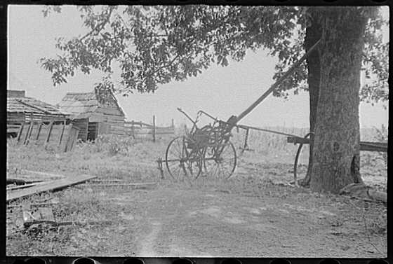
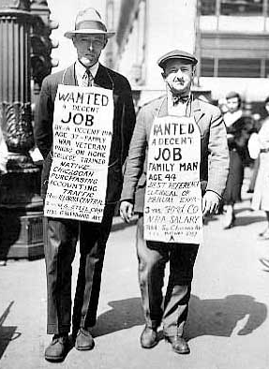
Post WWI: 1918-1920s
As Europe recovered, the wartime market disappeared
  Created a surplus of products and decreasing prices.
    ↑ Product = ↓Price
Many farmers could not make the payments on loans they had taken out for machinery, land, and seed during the war
  Banks began to foreclose on them.
A nationwide agricultural depression set in.
  1,000,000 + farmers had to seek employment in the cities.
The agricultural depression of the 1920s was only the beginning of the Great Depression
  Agricultural Depression would last until 1940

Slide 11
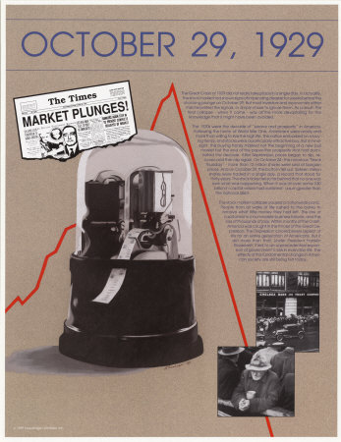
The Emergence of Modern America: 1920-1930
1921-1940 = Long-term agricultural depression
1922 =Capper-Volstead Act gives cooperatives legal standing
1924 = Immigration Act greatly reduces number of new immigrants
1925-1945 = Basic research done in land-grant colleges lays groundwork for second agricultural revolution
1929 = Stock Market Crashes
  Beginning of The Great Depression.

Slide 12
Growth
Average annual consumption of commercial fertilizer:
Agricultural exports:
1900-1910
  $917 million/year
  58% of total exports
1910-1919
  $1.9 billion/year
  45% of total exports
1920-1929
  1.94 billion/year
  42% of total exports
1900-1910
  3.7 million tons/year
1910-1919
  6.1 million tons/year
1920-1929
  6.8 million tons/year

Slide 13
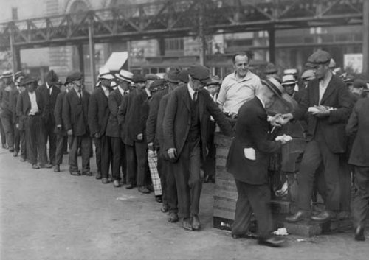
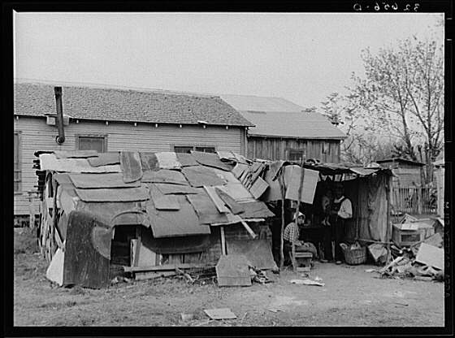
"In other periods of depression, it has always been possible to see some things which were solid and upon which you could base hope, but as I look about, I now see nothing to give ground to hope—nothing of man."
Former President Calvin Coolidge, 1932

Slide 14
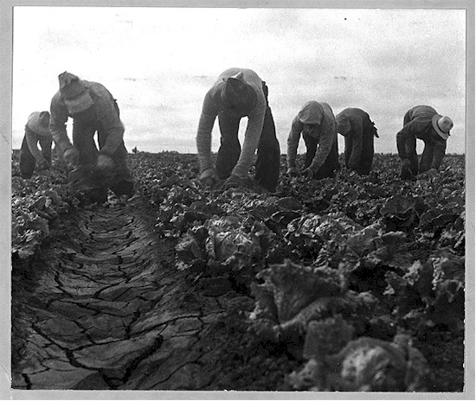
The Crash Lands
Stock Market crash of October 1929
  The price per bushel for wheat and corn dropped by more than 25% in a single year.
As the depression continued
  prices for almost all agricultural products dropped even further.
  The number of acres harvested and the yields per acre also fell for many crops
    Due to severe flooding in some parts of the country, and widespread drought in others.
  Agriculture was devastated as fields and streams dried up.
    Agricultural exports crashed
      Dropped $1 Billion dollars a year during the early 1930s.

Slide 15
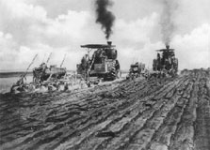
The Struggle to Adapt
Hoover administration made efforts to help.
  A Federal Drought Relief Committee was established in 1930.
    Recommended increased road and dam construction in drought areas.
In 1932 the situation worsened for American farmers and ranchers.
  The price of a bushel of corn dropped from $0.76 in 1929 to $0.29 in 1932;
  Beef prices dropped from $0.10 to $0.05 per pound.
Attributed the falling prices to two things:
  Revolutionary developments as the change from horses to motors
  Farmers lacked the education and skills they needed to understand how the market was working.
USDA tried to teach farmers to balance supply with demand.
  Urged farmers to voluntarily plant less of surplus crops like corn and wheat.
  Also promoted increased production of less plentiful crops
    Ex: planting tomatoes earlier than normal to produce a more crop, which would put more money in farmers pockets.

Slide 16
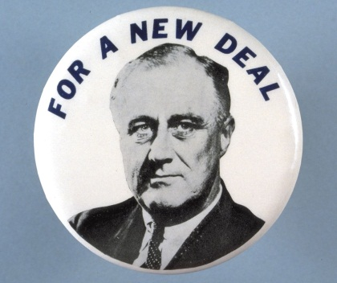
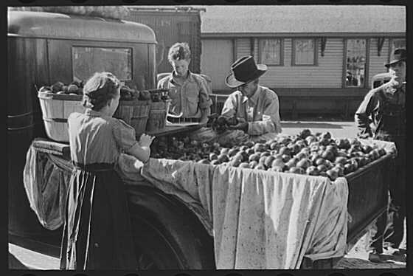
New Hope – New Deal
President Roosevelt took on the “farm problem” immediately.
  He visited poor farmers, shook their hands, and promised change.
  His wife, Eleanor, fought for the rights of sharecroppers and other minority groups in trouble.
Roosevelt firmly believed that solving the agricultural problems facing Americans was fundamental to easing the Depression.

Slide 17
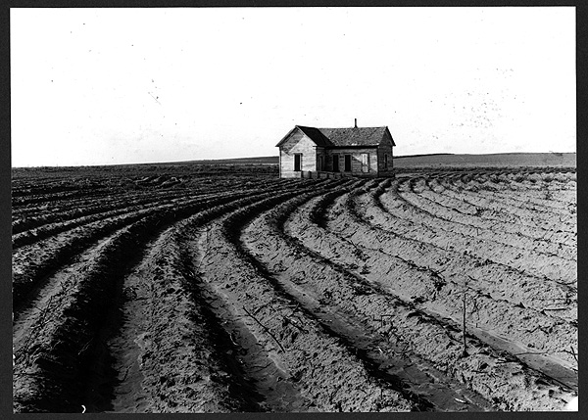
New Deal Programs
Designed to help farmers:
  The Agricultural Adjustment Acts
  The Civilian Conservation Corps
  The Farm Security Administration
  The Soil Conservation Service
  The Rural Electrification Administration
Programs focused on:
  Improving farm services,
  Reducing farm surpluses
  Increasing prices.

Slide 18
Agricultural Adjustment
Despite opposition, Roosevelt quickly signed the Agricultural Adjustment Act of 1933.
  Brought immediate change.
The Act provided for crop reduction through:
  Plow ups = paying farmers not to plant
    For example, under the first cotton contracts, growers agreed to plow up twenty-five to fifty percent of their crop before harvest, in exchange for cash payments
  Slaughtering millions of pigs.
Some farmers protested, but the plan showed positive results.
  Eventually caused a 50% increase in farm income

Slide 19
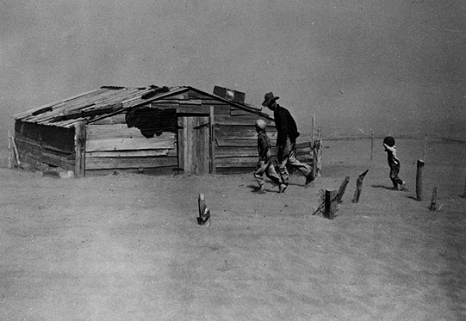
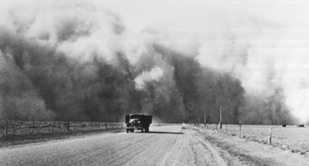
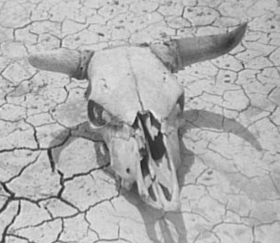
Dark Clouds for Ag: 1930-1935
Much of the nation faced devastating drought.
Dust storms swept away valuable layers of topsoil across TX, OK, KS, AR, NM, and CO.
Dust storms were made worse by the practice of plowing fields and leaving the soil exposed before planting in the spring.
These areas became known as the “Dust Bowl.”
Thousands of farmers were forced to move.

Slide 20
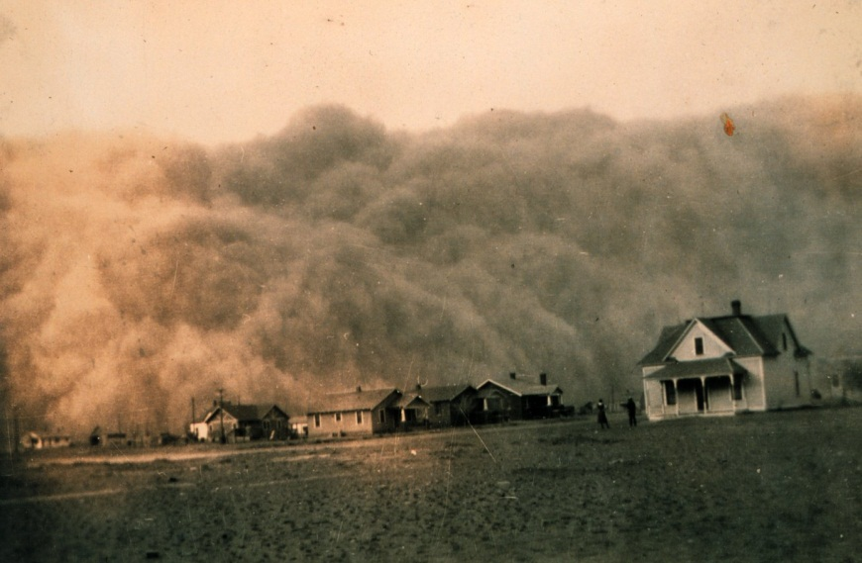
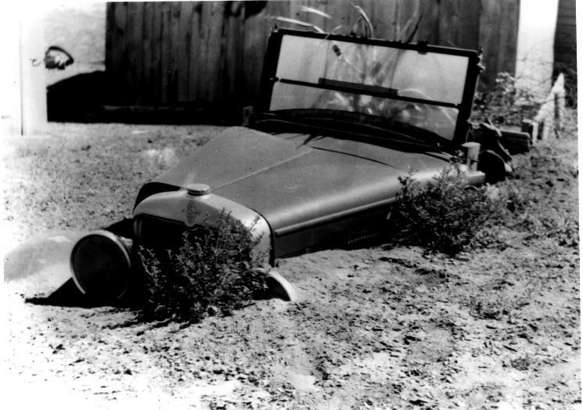
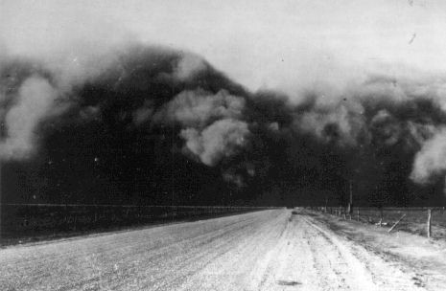
“Dust Bowl”
The Soil Conservation Act passed after a dust storm from the Midwest engulfed the Capitol in April 1935
The USDA’s soil conservation programs designed to help farmers change farming practices in order to prevent erosion.

Slide 21
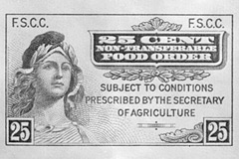
Programs and Progress: AAA of 1938
Congress passed second Agricultural Adjustment Act in 1938.
  Now funded by general taxation.
While legislative actions were helping farmers, many Americans were upset by the disparity of having farm surpluses while many people went hungry.
To help alleviate hunger and reduce surpluses the USDA initiated new food programs:
  The Food Stamps program (1939) provided surplus food to poor families
  School Lunch programs used surpluses to feed children.
The USDA built four new research labs across the nation to find new uses for agricultural products so that farmers could find new markets for their surpluses.
Once relief was flowing, attitudes improved.

Slide 22
STATS: 1930 vs. 1940
1930
1940
Total Population
  123 million
Farmers
  21% of labor force
Number of farms
  6.3 million
Average acres
  157 acres
Total Population
  132 million
Farmers
  18% of labor force
Number of farms
  6.1 million
Average acres
  175 acres

Slide 23
Pre WWII: 1939 - 1941
United States agriculture braced for the unknown as foreign markets closed and surpluses surged higher than ever.
Farmers were asked to produce only what was needed at home.
1941: USDA once again urged American farmers to produce more
Manufacturing of new armaments for the U.S. military and its allies increased:
  Jobs opened up everywhere
  Large numbers of men and women, especially minorities, left farm work for higher paying jobs in industry.
  Many former southern sharecroppers migrate to war-related jobs in cities

Slide 24
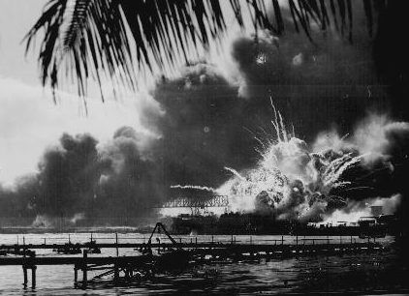
WWII
The attack on Pearl Harbor changed everything.
  Farmers dedicated themselves to the “defeat of the Axis.”
  They eagerly adopted science and technology to increase production, such as:
    Planting hybrid corn.
Even as farm output increased, food rationing went into effect.
Farmers began using more and more machinery to replace animal power.
  The shift away from horses and mules freed up more land for the production of feed grain for livestock and increased meat production.

Slide 25

1942: Shock Troops
By the end of 1942 farm labor became scarce.
To reduce the # of men leaving farms to go to war, the Government exempted 1,600,000 men from the draft.
  These farm workers helped fight the war on the home front.
  The “shock troops” of the countryside made a major difference.
By the end of the war U.S. food and fiber production reached record levels.

Slide 26
Ag Science & Research at War
During WWII, the USDA was increased research efforts to meet defense needs.
Needed Substitutes for:
  rubber,
  tropical oils,
  cork
  other imported products
The Japanese controlled much of the world’s supply of tropical agricultural products.
USDA scientists also developed better methods of food dehydration.
  “Instant” potatoes
  “Dried” milk
  “Powdered” eggs
  Combining various dried vegetables and meats into prepackaged soups.
Improved methods of food preservation helped reduce weight and bulk and made shipping and food storage easier.

Slide 27
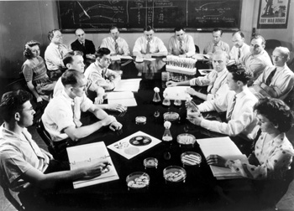
Ag Science & Research at War
New glues, plastics, paints and fabrics were developed from milk, soybeans, cotton and many other agricultural commodities.
The military adopted aerial mapping and photography techniques that had been pioneered by the USDA Forest Service
After the War, private industry commercialized many of the products developed by USDA researchers.

Slide 28

Ag Science & Research at War
Of all these endeavors, the mass-production of penicillin became the most important contribution of agricultural researchers during World War II.
  After the war it launched a new pharmaceutical industry.

Slide 29
The Post WWII Boom
To prevent the return of agriculture to pre-war Depression conditions, 4 million acres of crops were plowed up and a peacetime economy was formed.
1948: The Marshall Plan
  Response to notion that the U.S. has a “moral responsibility to feed the hungry people of the world.”
  The United States sent millions of tons of food abroad to prevent mass famine in the years after WWII.
  Livestock, seed, fertilizer and farm machinery were also sent overseas to help rebuild Europe’s agricultural system
    European farmers visited the U.S. to learn American farming techniques.

Slide 30
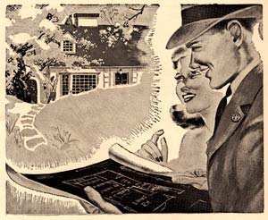

Post WWII: Leaving the Farm
Congress passed the G.I. Bill in 1944,
  Providing Veterans with educational and other benefits,
  Enrollment in land grant colleges soared.
More and more men and women graduated and took agricultural jobs off the farm with the goal of feeding the world.

Slide 31
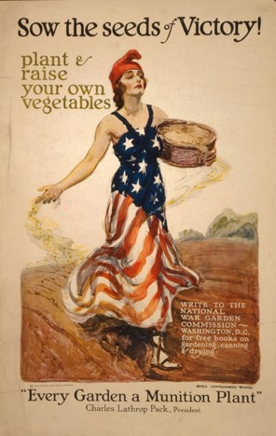
1940’s Trends
1940 on the Farm:
  58% of farms have cars
  25% of farms have phones
  33% of farms have electricity
1940
  584,000 students enrolled in agricultural courses
1941
  National Victory Garden Program
1941-1945
  Frozen foods popularized
1946
  National School Lunch Act

Slide 32
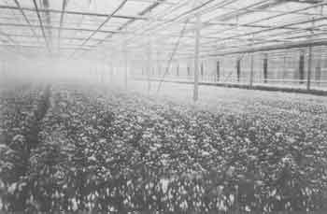
1940’s Trends
1940s – 1950s
  Acreages of crops, such as oats, required for horse and mule feed decrease sharply as farms use more tractors
1945-55
  Increased use of herbicides and pesticides
1945
  Food and Agriculture Organization of the Untied Nations established

Slide 33
Growth
Average annual consumption of commercial fertilizer:
Agricultural exports:
1920-1929
  1.94 billion/year
  42% of total exports
1930-1939
  $765 million/year
  32% of total exports
1940-1949
  $2.4 billion/year
  22% of total exports
1920-1929
  6.8 million tons/year
1930-1939
  6.6 million tons/year
1940-1949
  13.6 million tons/year

Slide 34
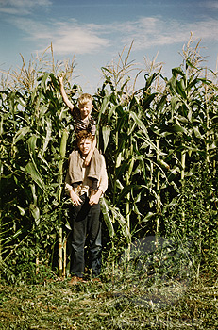
STATS: 1940 vs. 1950
1950
1940
Total Population
  132 million
Farmers
  18% of labor force
Number of farms
  6.1 million
Average acres
  175 acres
Total Population
  151 million
Farmers
  12% of labor force
Number of farms:
  5.4 million
Average acres
  216 acres

Slide 35
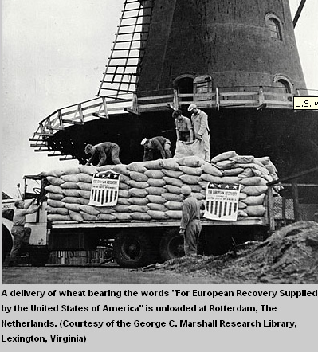
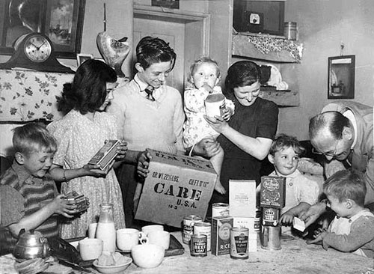
Peace & Prosperity: 1950s
The Marshall Plan helped U.S. farm exports skyrocket
  From $2 billion in the 1940s to nearly $4 billion in 1950.
  Helped restore European economy.
    US sent millions of tons of food abroad to prevent mass famine
    Livestock, seed, fertilizer, farm machinery sent to rebuild Europe’s agricultural systems
American farmers prospered due to record agricultural production and prices.

Slide 36
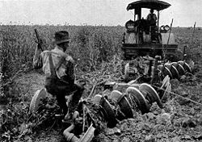
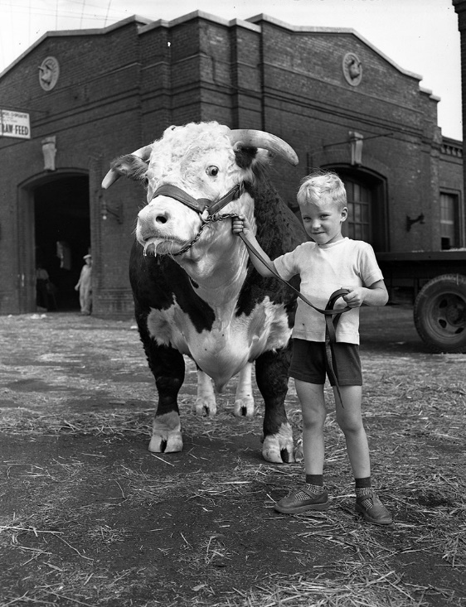
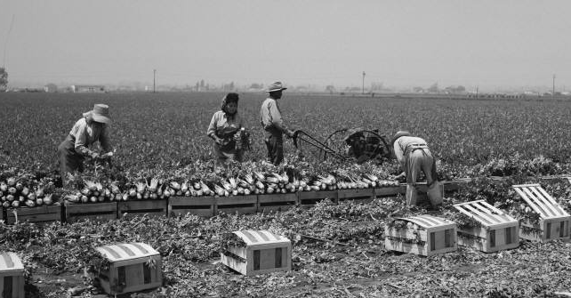
Farm Prosperity: 1950s
Farms became mechanized
  New pesticides, weed killers and chemical fertilizers increased crop yields.
Agriculture became more efficient
  Fewer farms but larger
  Fewer people needed to work farms
  Many left the countryside for work in the city and homes in the suburbs.

Slide 37

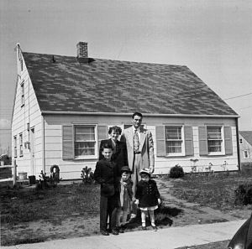

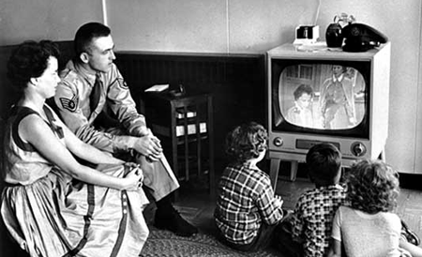
The Birth of “Suburbia”
Higher standard of living increased home and car ownership
More educational opportunities
A whole new economy based on “Consumerism”
  Television images increased public appetite for new products.

Slide 38
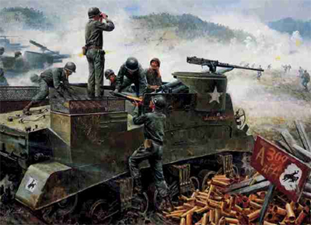
1950:The Cold War
Communist North Korea invaded South Korea.
  The US Re-armed
President Truman ordered USDA to increase agricultural production for the war.
  The American public asked to conserve food again by growing “Victory Gardens”.
The war became an economic boom for farmers

Slide 39
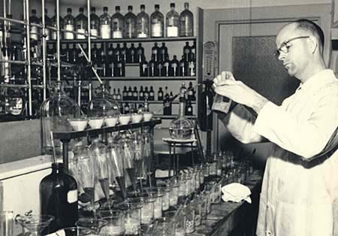
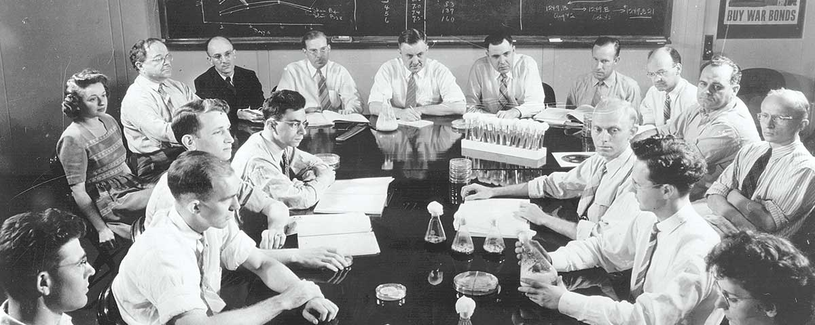
The 1950s
The USDA increased research
New fabrics developed to shield soldiers from burns, and protect wounds from infection.
  Dextran, a sugar produced from bacteria acting on cane or beet sugars, was developed to assist blood transfusions
Improved the flavor and stability of soybean oil
  Made a once insignificant crop one of America’s most important products

Slide 40
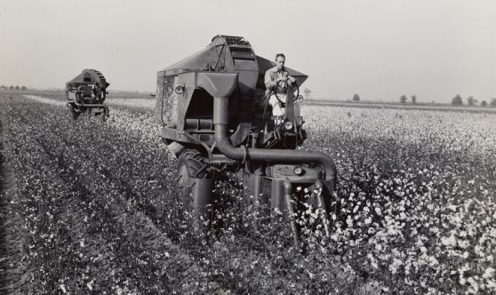
1950s: The Changing Face of Food & Farming
Big Farm Changes
  1950: Avg. farm size = 213 acres
  1960 = 297 acres
# of large-scale commercial farms continued to increase
  More efficient & productive.
Innovations increased productivity
  Mechanical cotton-picker
  Mechanized processing of peas from vine to freezer
Smaller farm owners had to seek extra $$ from other employment, or form “cooperatives” to compete with large-scale agriculture

Slide 41
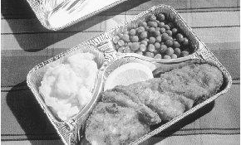

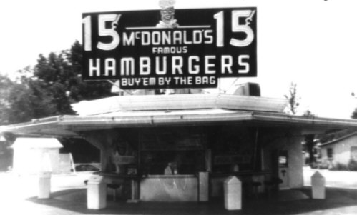
1950s: America’s Eating Habits Change
1954: 1st T.V. dinners = instant success
1955: Fast food = the 1st McDonalds
More prepared foods in the market
  Supermarkets began to replace corner grocery stores.
The frozen food industry boomed
  Americans bought larger refrigerator/ freezers
  Sought more convenience foods.

Slide 42

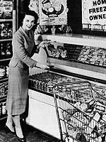
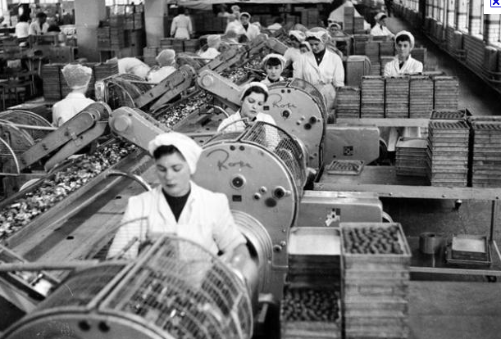
1950s: America’s Eating Habits Change
Increase in:
  # of working wives (+50%)
  % of working women with children .
Meals needed to be quick and simple for the new American household.
Improvements in refrigeration, transportation and processing
  Increased Variety
  Decreased Cost

Slide 43

1953:End of the Korean War
Surpluses = dramatic price drops for farm products.
Government encouraged farmers to produce less again and developed new markets for agricultural products.
1953: USDA established Agricultural Marketing Service (AMS) to solve problems of surpluses
  Improved packing of perishable fruits and vegetables
  Established better warehousing/food storage
  Improved food Quality
  Saved growers and the public $$$

Slide 44
Science & Technology
USDA Ag Research Service
  Agricultural scientists developed better breeds of plants & animals
  New techniques to stop insects from destroying crops.
USDA scientists developed new products:
  Washable woolens
  New cotton fabrics
  Better methods for making leather goods.
  DEET, highly effective insect repellant, for the Armed Forces.

Slide 45

Science & Technology
1954 = The number of tractors on farms exceeds the number of horses and mules for the first time.
1956 = Interstate Highway Act passed to build modern freeways across nation
  Now faster and easier for people to travel and ship agricultural products across America.

Slide 46

Late 1950s: American Ag Revolution
Low cost fertilizers widely used to renew nutrients in exhausted soil.
New pesticides and herbicides = increase in farm productivity.
By 1961: One farmer could feed 27 people
  Compared to feeding only 11 in 1940.

Slide 47


Food For Peace Program
Created in 1954 to use agricultural surpluses
Authorized USDA to buy surplus U.S. farm products for distribution to countries struggling to feed their people.
  American farmers benefited from increased exports
  Thousands in developing countries saved from hunger.

Slide 48


1950s
Rural areas lose population as farm family members seek outside work
1956 = Legislation for Great Plains Conservation Program
1957 = Poultry Inspection Act
1958 = Humane Slaughter Act
1959 = Mechanical Tomato Harvester

Slide 49
STATS: 1950 vs. 1960
1950
1960
Total Population
  151 million
Farmers
  12% of labor force
Number of farms
  5.4 million
Average acres
  216 acres
Total Population
  180 million
Farmers
  8% of labor force
Number of farms
  3.7 million
Average acres
  303 acres

